Slide 1
ECON 672
Week 3: Causal Diagrams and Directed Acyclic Graphs
Samuel Rowe, PhD 12/15/2022

Slide 2
Overview
Directed Acyclic Graphs (DAG)
Confounders
Colliders
Selection Bias in Data Selection

Slide 3
Directed Acyclic Graphs

Slide 4
Directed Acyclic Graphs
Directed Acyclic Graphs (DAGs) are a chain of causal effects in graphical form
One of of many contributions to causal inference from Judea Pearl (2009)
DAGs are a model
Based upon unobserved structural process
Equilibrium values of a system of behavioral equations

Slide 5
Directed Acyclic Graphs
Upfront statements about DAGs
1) Causality usually runs in one direction
No time cyclic in DAGs (hence acyclic)
2) Reverse causality should be handled in a different way
Simultaneity, such as supply and demand models, would require multiple nodes and are not best handled with a DAG
3) DAGs explain causality in terms of counterfactuals
Causal effects through two potential states

Slide 6
Directed Acyclic Graphs
Arrows and Nodes
Nodes are circles and they represent random variables
Arrows between nodes represent direction of causality
Causal effects can occur in two ways
1) Direct
2) Indirect

Slide 7
Directed Acyclic Graphs
Direct Causal Effect
One variable directly affects another variable
$$D→Y$$
Indirect Causal Effect
Our treatment variable D is mediated by a third variable, such as X
$$D→X→Y$$

Slide 8
Directed Acyclic Graphs
DAGs are meant to show all causal relationship of the model
These are theoretical representations of phenomena you are interested in studying
These can be develop through theory or prior literature
What is included is just as important as what is not included
Direction of arrow between nodes imply causality
A lack of an arrow implies no causal relationship
A complete DAG will have all direct effects among the variables including common causes of any pair of variables

Slide 9
Why Use Directed Acyclic Graphs
A useful state-of-the-art knowledge of the phenomena you are interested in studying
Shows theory, literature, and institutional/prior knowledge
They provide a picture representation of your model
Visually displays your research design and identification strategy
Corroborates your research design
Shows causal effect of intervention by showing backdoor criterion and collider biases
Provides your assumptions

Slide 10
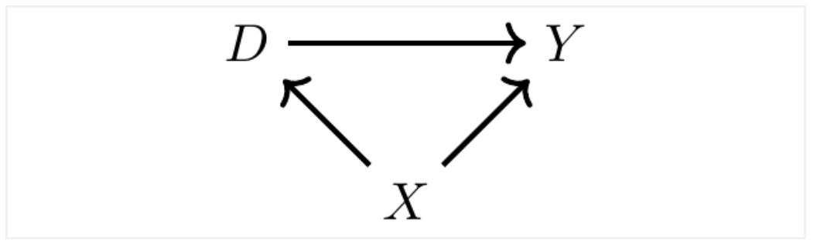
Simple DAG

Slide 11
Simple DAG
We have 3 random variables
D is our treatment
Y is our outcome of interest
X is a variable that affects both D and Y

Slide 12
Simple DAG
There are two pathways affecting Y
1) Direct Pathway: $D→Y$
This is our causal effect of interest
2) Indirect Pathway: $D←X→Y$
A backdoor pathway shows that D and Y take on different values when X takes on different values
This means that part of the correlation between D and Y is spurious due to X

Slide 13
Confounders

Slide 14
Confounders
The backdoor pathway is one of the most important concepts with DAGs
When X mediates the values of D and Y, then X is considered a confounder
Use the Simple DAG example
X is a confounder
It jointly impacts D and Y
There are two pathways contained in the correlation between D and Y
Backdoor paths are similar to Omitted Variable Bias
Leaving a backdoor open is similar to not controlling for a variable

Slide 15
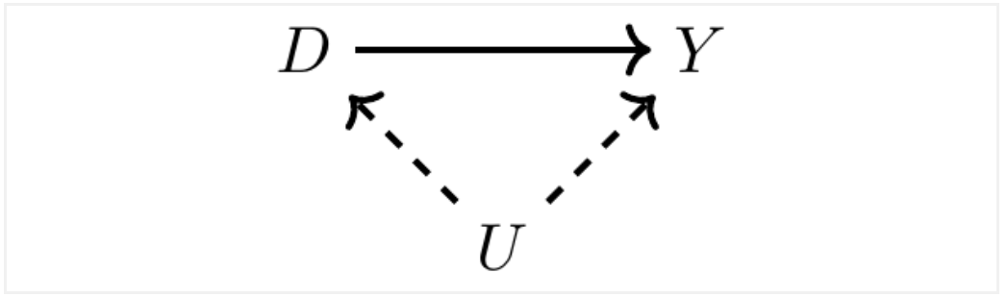
Unobserved Confounders
Here is an example of a DAG with unobserved confounder
Unlike X, U is unobserved and jointly impact D and y
We will use dash lines to indicate that the variable is unobserved

Slide 16
Unobserved Confounder
There are two pathways similar to our simple DAG
Direct: $D→Y$
Indirect: $D←-U-→Y$
Since U is unobserved
The pathway remains open since we cannot control for it

Slide 17

DAG Example: College Education and Earnings

Slide 18
DAG Example
The model shows us two things
Pathways
Assumptions
There are several variable in this DAG
Y is observed earnings
D is observed college education
PE is observed parental education
I is observed family education
B is unobserved background characteristics, such as genetics, family environment, mental ability, etc.

Slide 19
DAG Example
There are 4 pathways here
Direct: $D→Y$
Indirect Backdoor 1: $D←I→Y$
Indirect Backdoor 2: $D←PE→I→Y$
Indirect Backdoor 3: $D←-B-→PE→I→Y$

Slide 20
DAG Example
Narrative of this Example DAG
College education [0,1] affects child’s earnings $(D→Y)$
Family income affects child’s income due to bequests, transfers, etc
Parent’s education affects family income and child’s choice of college education
Family background characteristics affect parents education choice and child’s education choice
Assumption
Background characteristics do not directly affect child’s earnings
Assumption is the background characteristics work indirectly through parent’s and child’s education choices

Slide 21
Example DAG
If we naively compare outcomes of college education to no college education
It will be biased due to several backdoors not being closed

Slide 22
Colliders

Slide 23
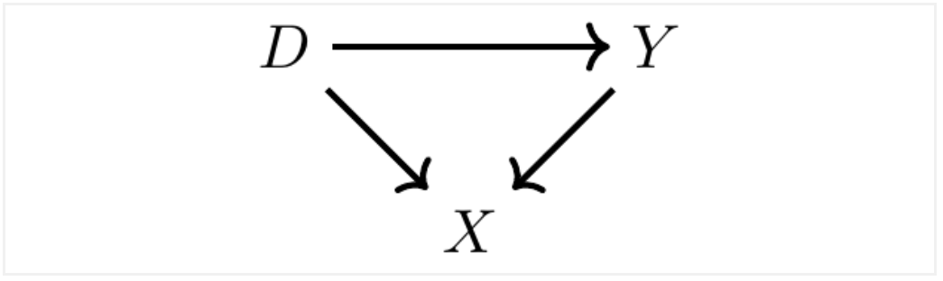
Colliders
Colliders are different from confounders
Colliders occur when two variables cause a third variable
They are a bit more complex than confounders
Unlike a confounder, controlling for a collider will introduce bias
Angrist and Pischke (2009) refer to these as bad controls

Slide 24
Colliders
We have three variables, D, X, and Y
D and Y collide at $D→X←Y$, such that changes in D and Y cause changes in X
We have two pathways
Direct: $D→Y$
Indirect (Backdoor): $D→X←Y$
Key Point
Leaving a collider alone closes the backdoor pathway
If you control for the collider, you reopen the backdoor pathway

Slide 25
Backdoor Criterion
Backdoor pathways are indirect pathways between D and Y
These matter since the create systematic noncausal relationships between our treatment of interest (D) and outcome of interest (Y)
Open backdoor pathways
These are omitted variable bias
Our Goal
Close all backdoor pathways
Identify the direct pathway between D and Y
We use an identification strategy to achieve our goal in the DAG

Slide 26
Backdoor Criterion
Two ways to close the backdoor criterion
1) Controlling or conditioning on the confounder
2) The appearance of a backdoor collider
Backdoor Criterion
Backdoor criterion is satisfied when all backdoor pathways are closed

Slide 27
DAG Example: College Education and Earnings
How do we satisfy the backdoor criterion in our college education and earnings example?

Slide 28

DAG Example: College Education and Earnings
How do we satisfy the backdoor criterion in our college education and earnings example?

Slide 29
DAG Example: College Education and Earnings
We can close all backdoor pathways when we control for Family Income
Family income runs along all backdoor pathways
This is the minimally sufficient strategy to satisfy the backdoor criterion
$$Y_{i}=α+\overset{̂}{δ}D_{i}+βI_{i}+ε_{i}$$
$\overset{̂}{δ}$ takes a causal interpretation when we satisfy the backdoor criterion

Slide 30

Skepticism of DAG Strategy
Is the assumption that family background doesn’t affect sufficient?
This is the importance of theory, literature, and prior knowledge
If family background does impact the child’s college choice, then controlling for family income is an insufficient strategy, since $D←-B-→Y$

Slide 31
Bias Examples
There are no flags for confounders or colliders in a data set
We need knowledge of the data-generation process, theory, prior literature, and logic to assign confounders and colliders
As mentioned colliders are a bit weird
When we condition or control for a collider, we introduce bias
We open the backdoor pathways when we control for a collider
We should be familiar with confounders that we have seen in econometrics
When we do not condition or control for a confounder, we introduce bias

Slide 32
Bias Examples
Setting up a DAG: You need theory, prior literature, and prior knowledge of data-generation process
These flag colliders and confounders
These establish your assumptions

Slide 33
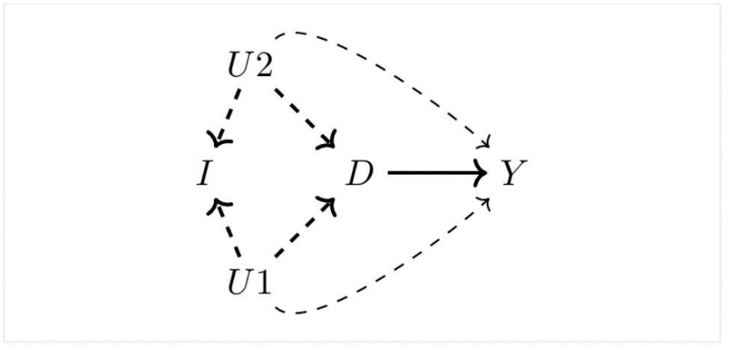
Collider Bias Example 1: College and Earnings
We revisit the child’s college choice
D is child’s college choice
Y is child’s earnings
I is family income
U1 is mother’s unobserved ability
U2 is father’s unobserved ability

Slide 34
Collider Bias Example 1: College and Earnings
We have a few pathways
Direct: $D→Y$
Backdoor 1: $D←-U_{1}-→Y$
Backdoor 2: $D←-U_{2}-→Y$
Backdoor 3: $D←-U_{1}-→I←-U_{2}-→Y$
Backdoor 4: $D←-U_{2}-→I←-U_{1}-→Y$
If we condition on family income, I, we will introduce collider bias
The backdoor pathways of 3 and 4 are closed as long as we do not condition on family income, I
We need an identification strategy that takes care of time-invariant ability of parents

Slide 35
Collider Bias Example 2: Discrimination
It is common to hear that wage disparity reduces or disappears when you control for occupation
An example is when an internal Google study showed that wage disparity was eliminated when they controlled for occupations within Google
If discrimination come from job/occupational sorting, then controlling for occupation introduces collider bias
Worsens the bias of the estimate

Slide 36
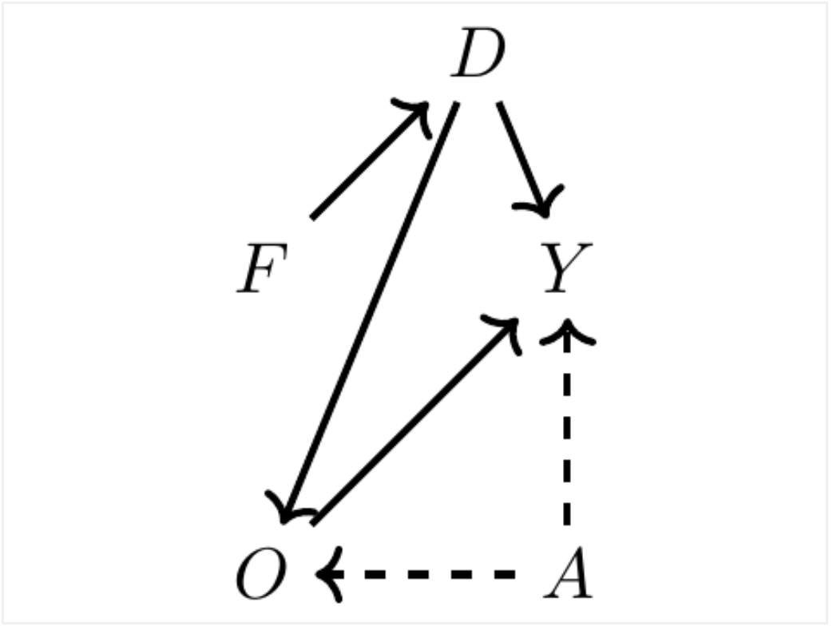
Collider Bias Example 2: Discrimination
Set up the DAG
Y is earnings
D is “treatment” of discrimination
O is occupation
F is female
A is unobserved ability

Slide 37
Collider Bias Example 2: Discrimination
Pathways
Direct Pathway: $D→Y$
Mediated Pathway: $D→O→Y$
Backdoor Pathway: $D→O←-A-→Y$
Mediated Pathway
This means that discrimination is mediated by occupation
It implies that discrimination affects the jobs or occupations that female can hold
Discrimination means that women have fewer opportunities for higher paying jobs

Slide 38
Collider Bias Example 2: Discrimination
Assumptions (what is not shown)
Female status has no direct impact on earnings
Direct Pathway
Implies discrimination impact earnings
Mediated Pathway
Implies women are discriminated against by what kind of jobs they are offered
Backdoor Pathway
Implies ability affects earnings and occupations they sort into

Slide 39
Collier Bias Example 2: Discrimination
Stata Example
We can get a total effect of discrimination onto earnings
Direct and Mediated
When we control for occupation
It closes the mediated pathway, but opens up the backdoor pathway and introduces bias
This happens since ability does not affect D directly
Ironically, controlling for occupation makes the bias worse
We need an identification strategy that controls for ability
We have ability in our example, but in real life we don’t

Slide 40

Collider Bias Example 3: Sample Selection
Collider bias can be baked into the sample
If the sample itself is a collider
There is a story about beauty and talent being inversely related or negatively correlated for actors
$$Talent→MovieStar$$
$$Beauty→MovieStar$$

Slide 41
Collider Bias Example 3: Sample Selection
Stata Example
If there is a cutoff between all actors that separates movie stars and aspiring actors, then the frontier has a negative relationship
Movie Star status creates a collider bias when there is no relationship between beauty and talent
Movie Star status introduces a negative correlation between talent and beauty

Slide 42
Collider Bias Example 4: Policing and Admin Data
DAGs can help spot subtle forms of conditioning on colliders and collider bias
For example, admin data may be rife with collider bias
Main problem with admin data
Admin data may be condition on an interaction occurring
Police interactions is the exampled used, but there could be many types of conditional interactions, such as wage violations, health violations, etc.

Slide 43
Collider Bias Example 4: Policing and Admin Data
What is the data-generation process?
For the police admin data, data generation is conditional on a police interaction
The data-generation process is a function of police interactions
This means admin data are endogenous

Slide 44
Collider Bias Example 4: Policing and Admin Data
Fryer (2019) wanted to study police force and racial bias
He uses several public-use databases to study this problem
NYC Stop and Frisk database
This contained data on police stops and questioning of pedestrians
Police-Public Contact Survey
This was a survey of civilians describing interactions with police including the use of force from Houston
The main problem is that these data are condition on police-civilian interactions

Slide 45
Collider Bias Example 4: Policing and Admin Data
Fryer (2019) finds in the NYC data
Blacks and Hispanic/Latinos were 50 percent more likely to have a interaction with police in the data
Blacks were 21 percent more likely than Whites to have an interaction with police in which a weapon was drawn
Fryer (2019) finds a similar result in the Houston data
The racial differences are larger in the Houston data

Slide 46
Collider Bias Example 4: Policing and Admin Data
Fryer (2019), however, concludes that there is no racial difference in officer-involved shootings
He controls for suspect demographics, officer demographics, encounter characteristics, suspect weapon, and year fixed effects
With his model, Fryer (2019) finds
Blacks were 27 percent less likely to be shot by police than non-Black Non-Hispanics
Strength of the study
Gathering the labor-intensive process of compiling the admin data
He is able to gather observed confounders that would have been unobserved without compiling the admin data

Slide 47
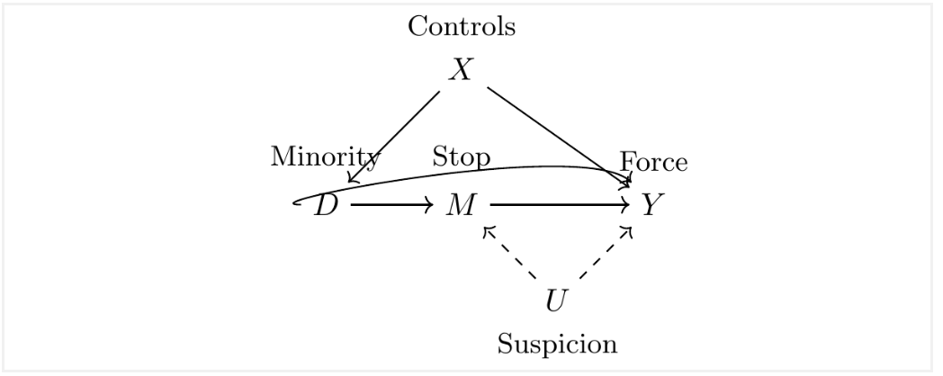
Collider Bias Example 4: Policing and Admin Data
A critic of the study
Administrative data were endogenous since they were conditioned on a collider
DAG
Y is forced used
D is Black or Hispanic/Latino
M is police stop
X are other controls
U is unobserved suspicion

Slide 48
Collider Bias Example 4: Policing and Admin Data
Pathways
Direct Pathway: $D→M$
Mediated Pathway: $D→M→Y$
Backdoor Pathway 1: $D←X→Y$
Backdoor Pathway 2: $D→M←-U-→Y$

Slide 49
Collider Bias Example 4: Policing and Admin Data
Fryer’s (2019) data collection by compiling X controls closes that backdoor
The direct pathway from Black/Hispanic onto Stops exists within the literature
M is a collider along the second backdoor pathway
Fryer’s (2019) results are conditional on police stops or interactions
Understanding potential selection into police data due to bias in who the police interacts with is a difficult endeavor
Knox, Lowe, and Mummolo (2020) revisit Fryer’s (2019) question and find that after applying bias correction
Lower bound estimates of police violence against civilians were 5 times higher than traditional approaches that ignores the sample selection problem

Slide 50
Concluding Thoughts on DAGs
DAGs are a useful tool to clarify relationships among variables
Guides you to a credible identification strategy
Atheoretical approaches to empiricism are subject to fail
Knowledge is essential for the establishing a credible identification strategy
More data or “Big Data” do not solve the problem of potential outcomes
More data is an insufficient substitute for theory and literature
More data is an insufficient substitute for deep institutional knowledge
More data is an insufficient substitute for knowledge of data-generation process

